Slide 1

Question: If you could redo Harvard-Westlake, where you get to test a different version of your life here. Different teachers, different classes, different social choices, different ways of handling pressure. Would you do it?

Slide 2
Extra Credit
By: Ryan Kim

Slide 3
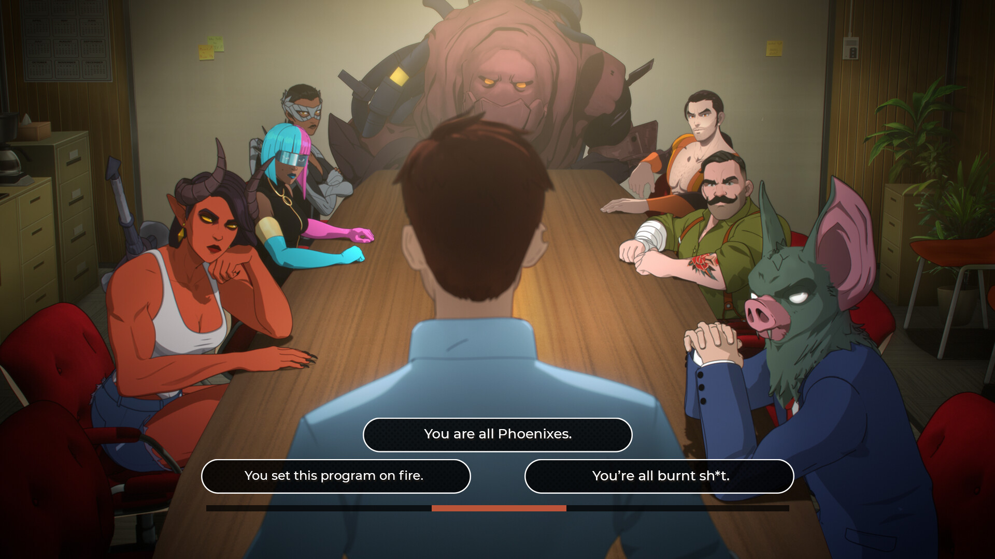

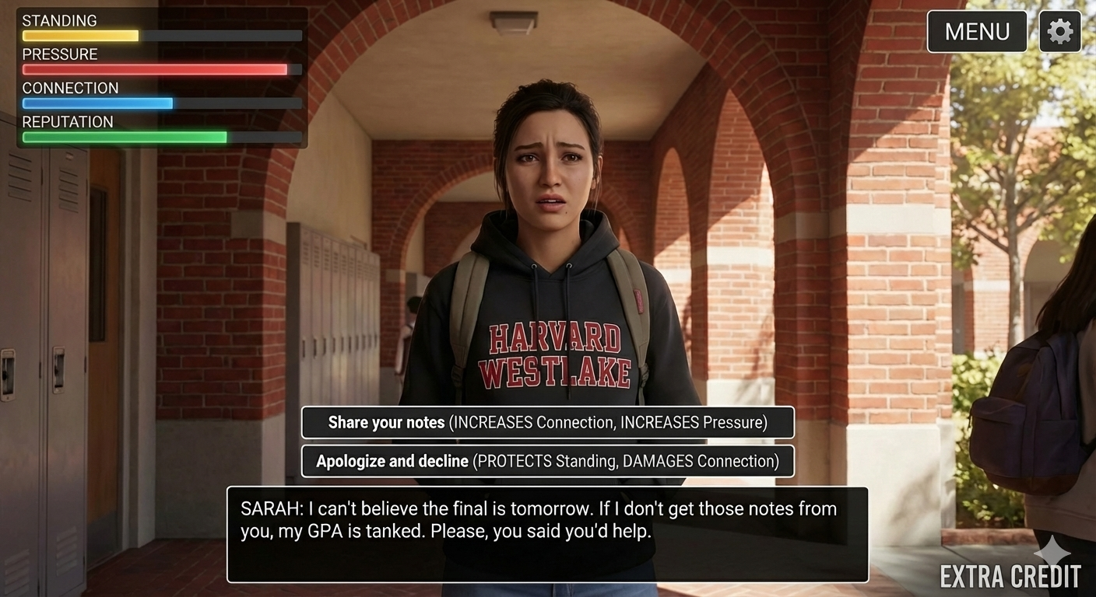
Overview
Extra Credit is a cinematic, choice-driven narrative RPG set at Harvard-Westlake. Players navigate high school by making decisions about academics, relationships, and personal priorities, all while responding to institutional pressure and limited time.
Narrative Navigation: Players progress through the game by moving between key locations on campus (classrooms, common spaces, offices, events) and engaging in story-driven scenes rather than free movement. Each location presents unique dialogue options and decision points that advance the narrative.
Choice-Based Decision Making: At critical moments, players are presented with choices related to academics, relationships, and personal priorities. These choices are permanent and directly influence future dialogue, available opportunities, and story paths.
Dispatch
Road to Empress (real actors example)
Extra Credit
(example made with AI)

Slide 4
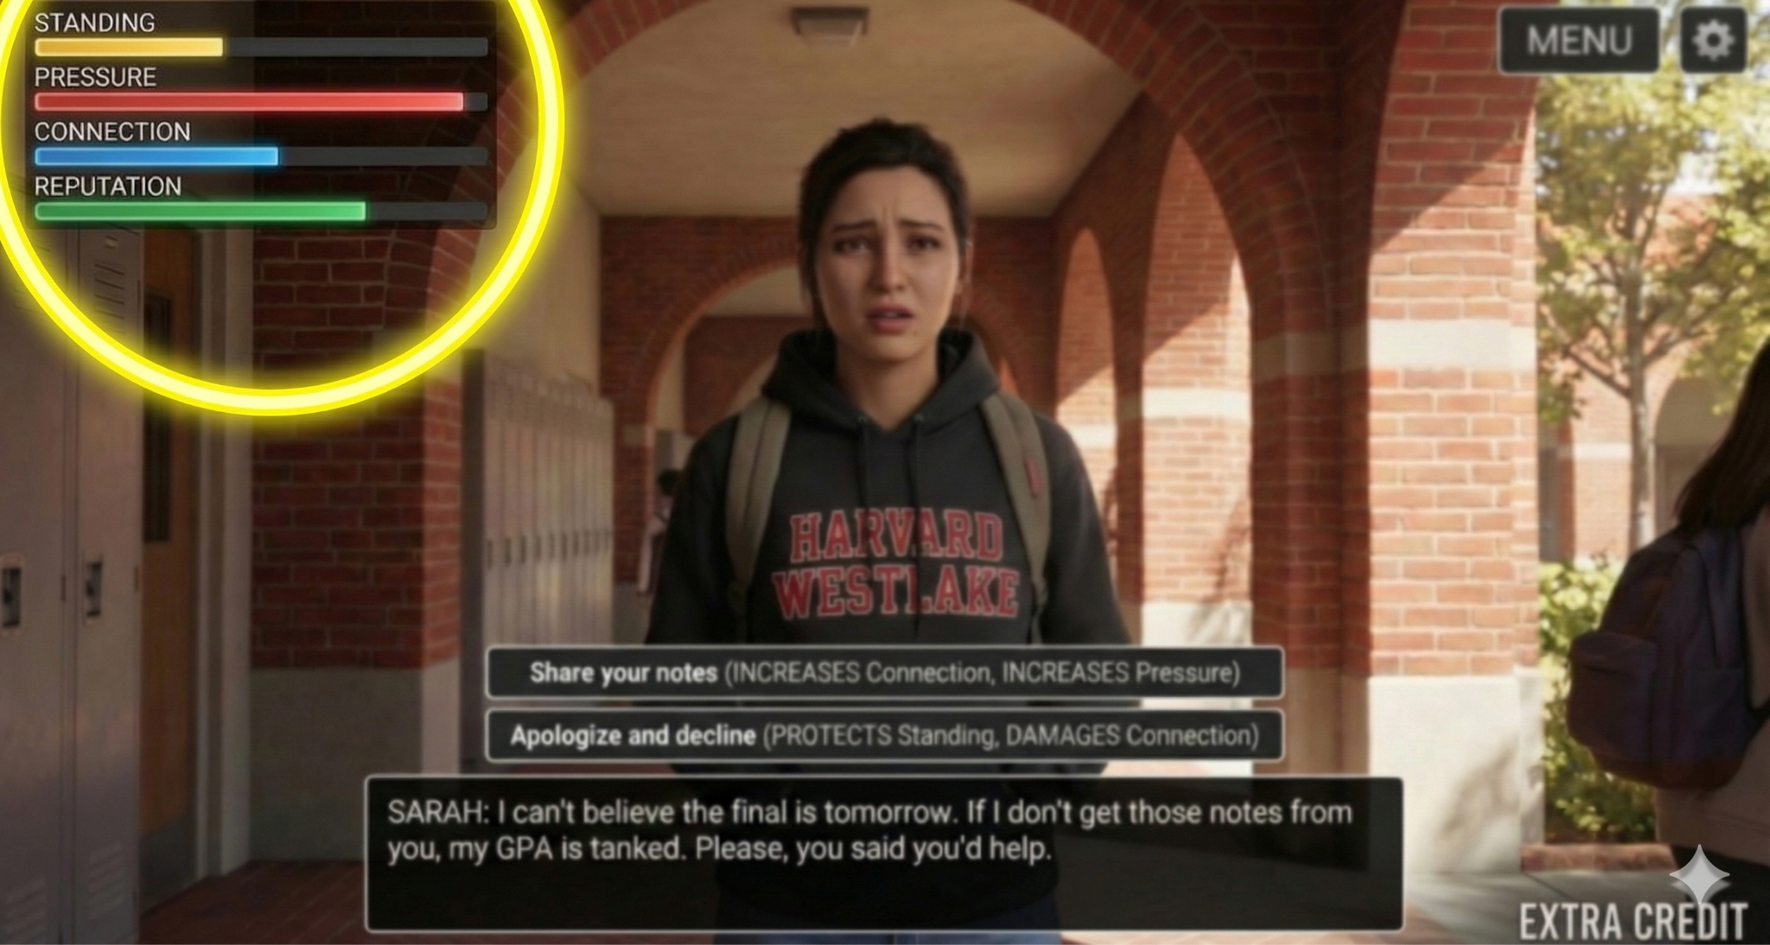
Visible Stat Meters
The game uses four visible meters displayed on screen to track the player’s progress and influence narrative outcomes. These meters update immediately after major decisions, clearly showing the consequences of player choices.

Slide 5

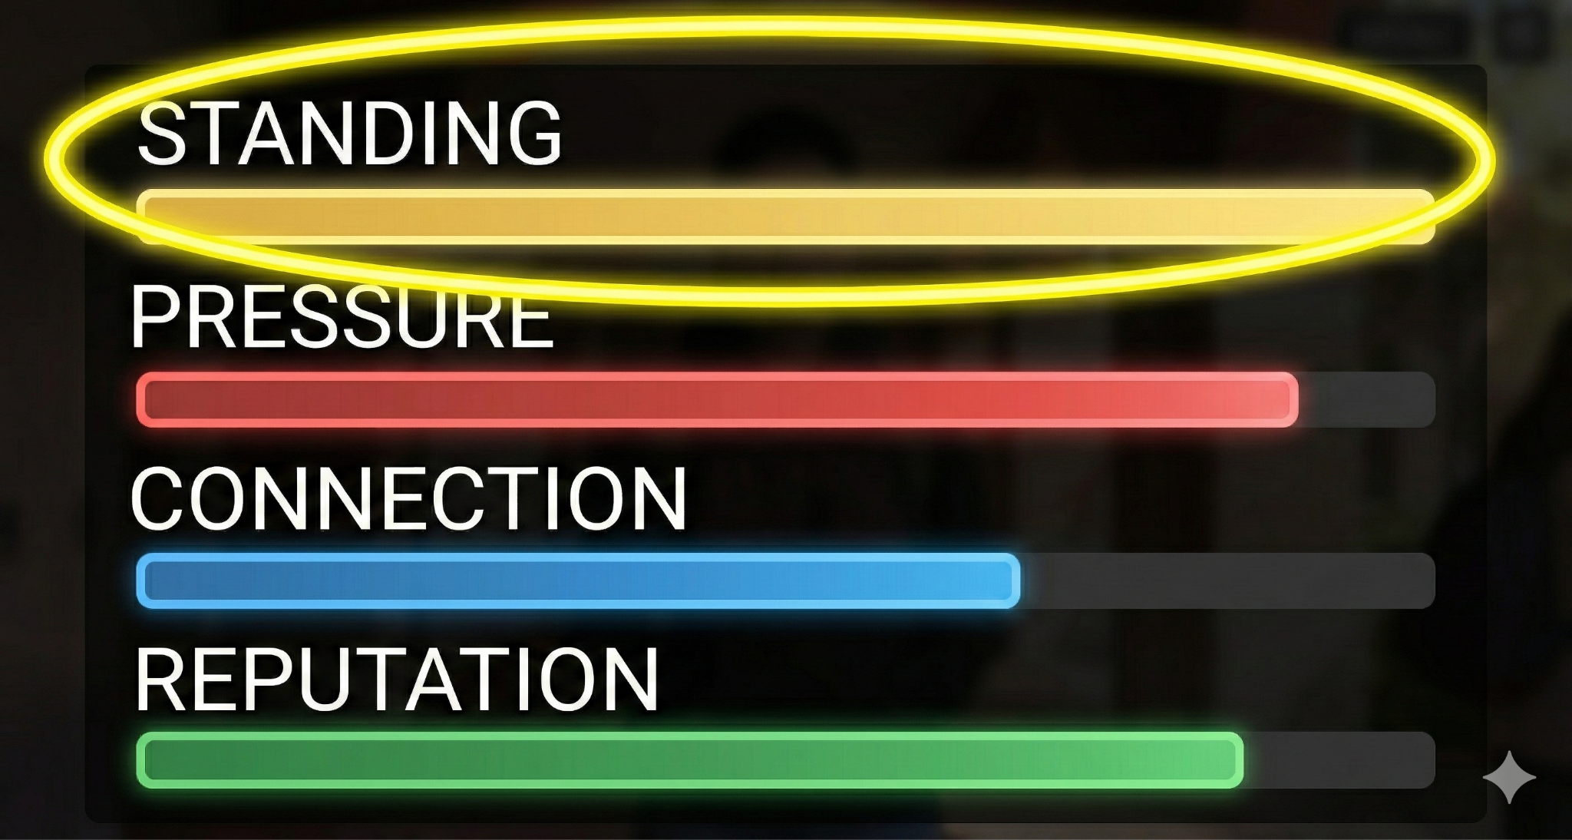

Standing
Represents the player’s position within the school’s social and institutional hierarchy. Higher standing increases access to opportunities, support from teachers, and favorable outcomes, while lower standing limits influence and flexibility.

Slide 6
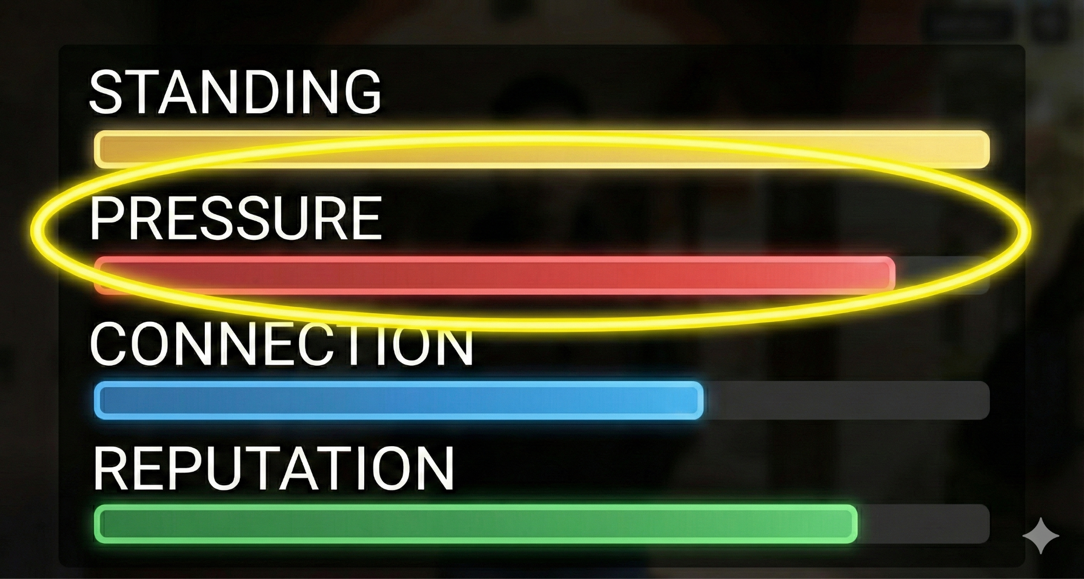


Pressure
Measures accumulated stress and burnout. As pressure increases, certain dialogue options may become unavailable, scenes may take on a more negative tone, and long-term consequences become more severe.

Slide 7
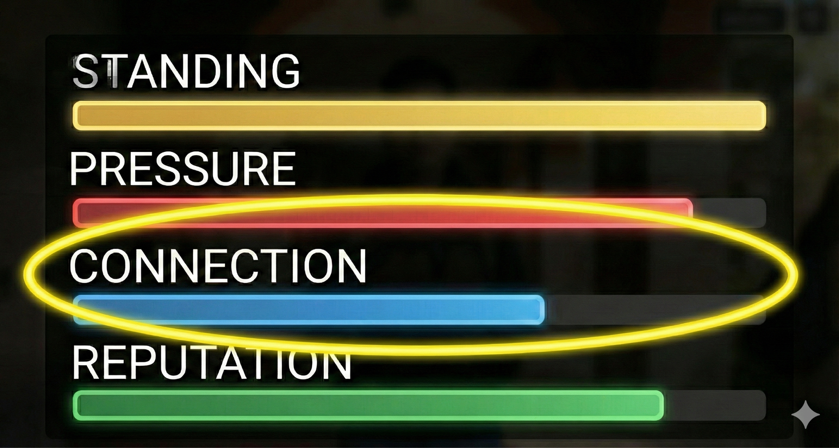


Connection
Tracks the strength of relationships with peers and teachers. Strong connections unlock additional dialogue options, support during difficult moments, and alternative story paths.

Slide 8

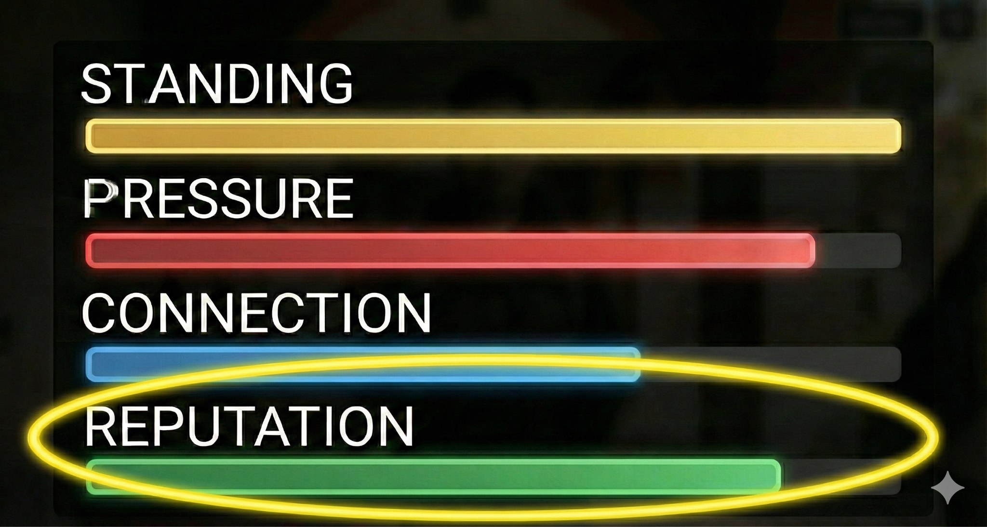

Reputation
Reflects how the institution formally perceives the player. Reputation influences administrative decisions, academic opportunities, and how strictly rules are applied to the player.

Slide 9
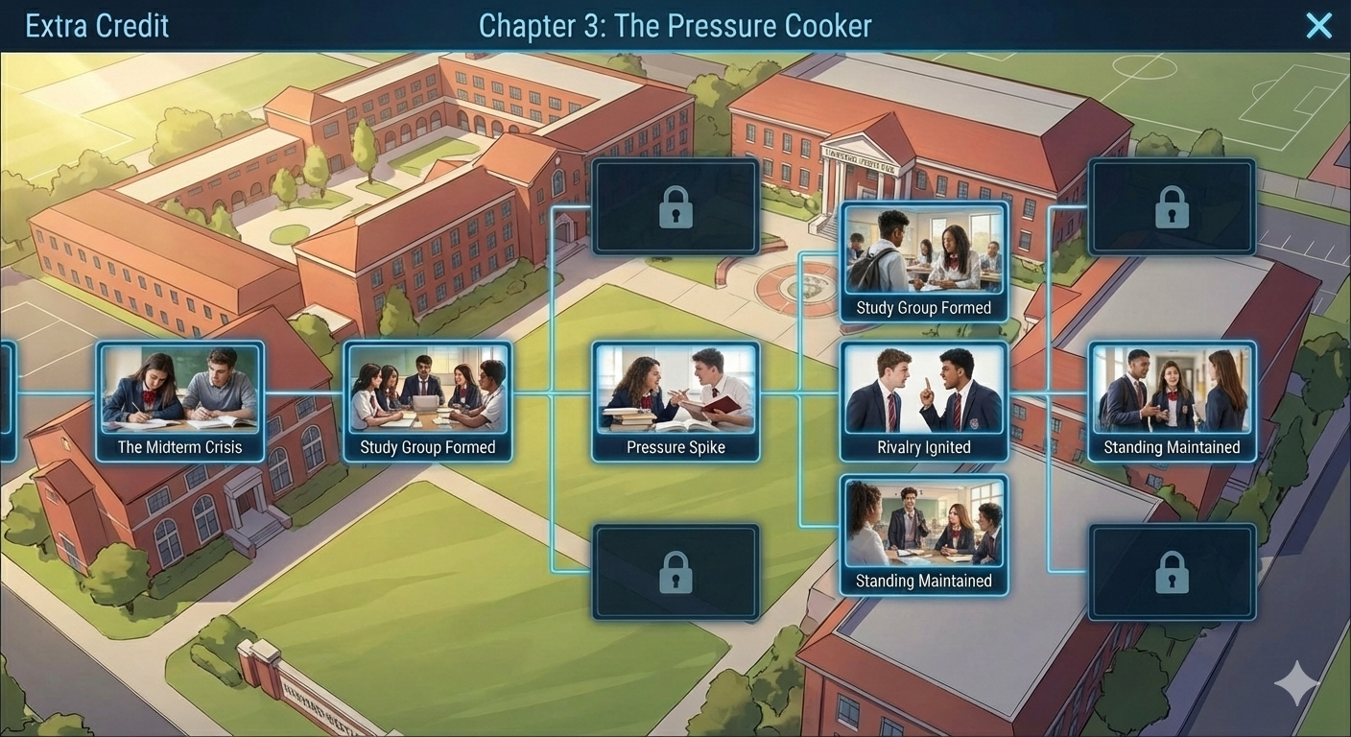
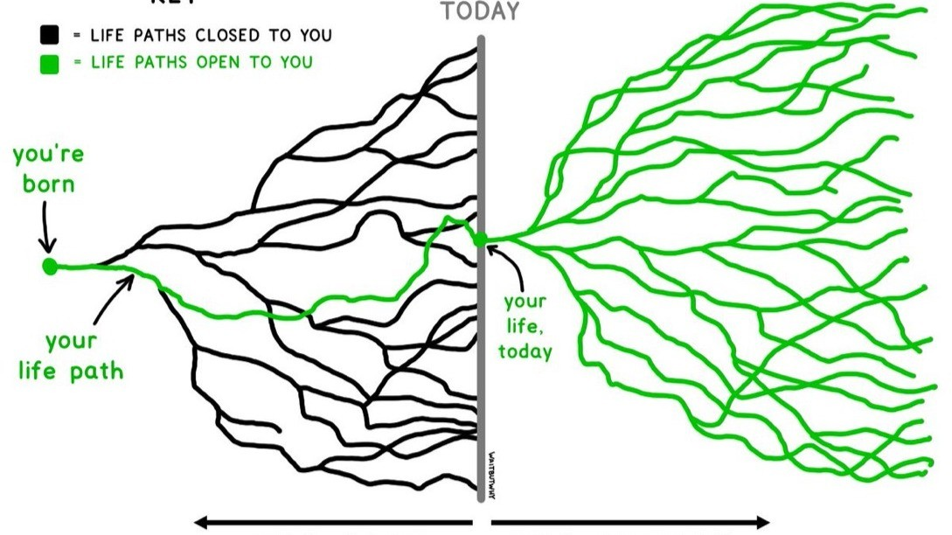
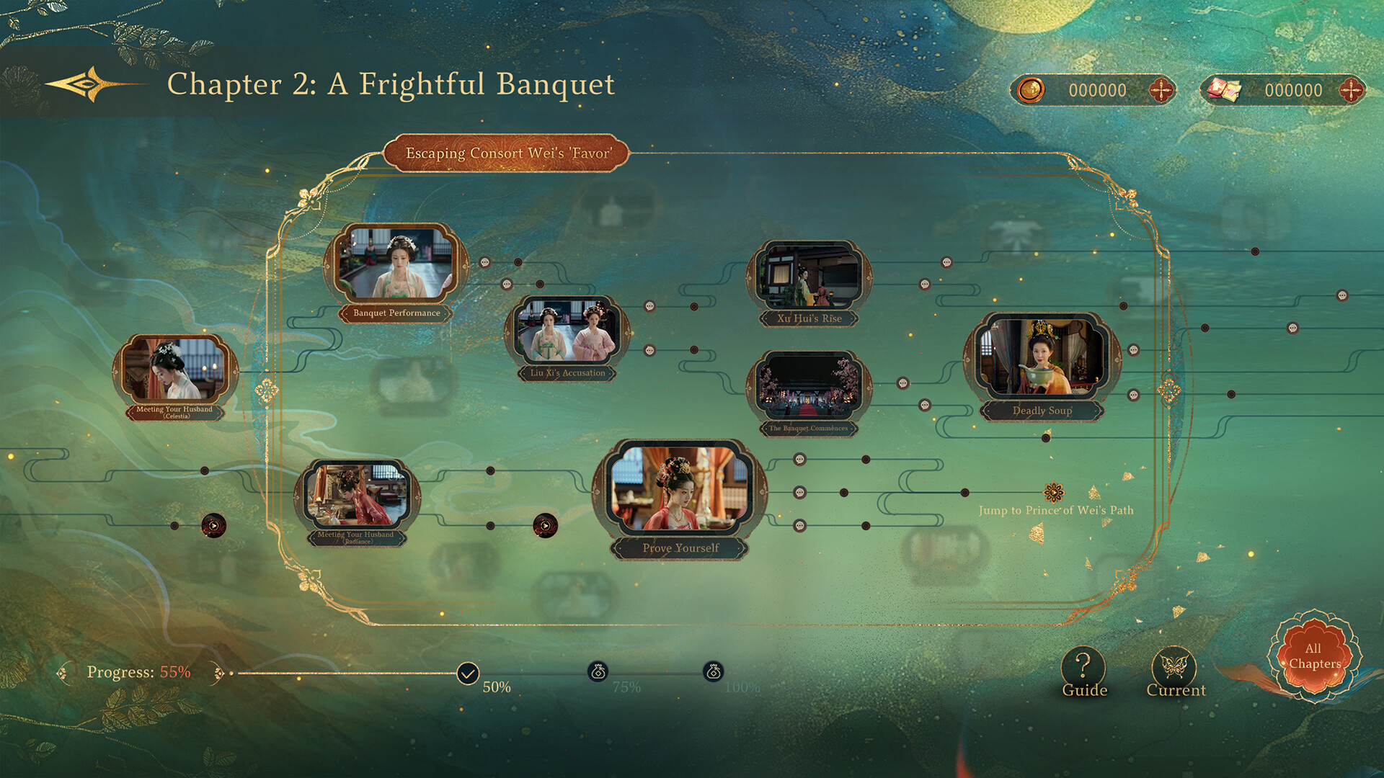
Story Progress Panel
Players can access a dedicated panel that displays a branching path map of the narrative. This panel shows which scenes have already been played, which paths are currently locked, and which story branches remain unexplored. The panel allows players to understand the structure of the story without revealing future outcomes, encouraging replayability and reflection on past choices.

Slide 10



Purpose of the Game
Goal: Provide a cinematic, choice-driven narrative experience that allows players to explore how decisions made during high school shape identity, opportunity, and long-term outcomes. Rather than focusing on winning or optimization, the game’s goal is to guide players toward graduation while encouraging reflection on how ambition, relationships, and pressure interact over time.
Objective: The player’s primary objective is to graduate from Harvard-Westlake. Along the way, players make academic, social, and personal choices that influence their standing within the school, their stress levels, and their relationships. The game emphasizes that while effort and recovery are sometimes possible, not all consequences can be undone.

Slide 11


Thank You
Full info doc with more details: https://docs.google.com/document/d/1Hk7FSeeHH1It0UL31UsarEptJuHjbBfCpN2OzMxH4KI/edit?usp=sharing

